Slide 1
Data Provenance
Maximilian Höller

Slide 2
What is Provenance?
Definition: Provenance refers to the origin, history, and lifecycle of data, processes, and decisions.
Importance in Machine Learning:
Transparency: Track how data is sourced, transformed, and used.
Accountability: Identify who or what contributed to the training process.
Reproducibility: Ensure results can be traced back and replicated.

Slide 3
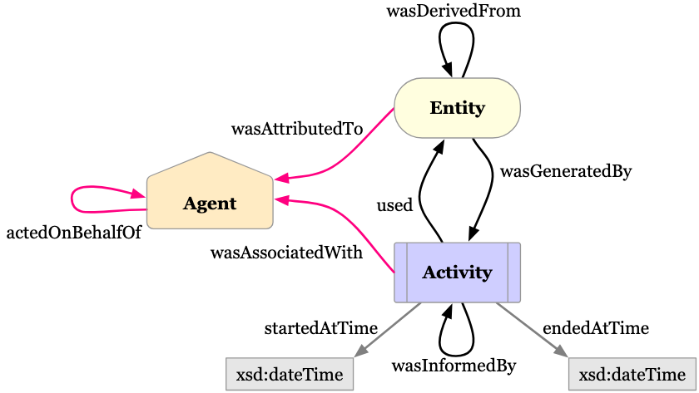
PROV-O
What is PROV-O?:
PROV-O is a W3C recommendation for modeling and representing provenance information.
It uses an ontology-based approach to provide a structured way of capturing the relationships between entities, activities, and agents.
Core Components:
Entity: Represents the data or object.
Activity: Describes processes that produce or modify an entity.
Agent: People or organizations responsible for activities.
Notes:
graph bigger??

Slide 4
Implementation
Based on MLProvLab by Sheeba Samuel (TU Chemnitz):
The MLProvLab project structures provenance data in JSON format, capturing key elements such as entities, activities, and agents in machine learning workflows.
Enhancements and Development:
A Python script was developed to convert the JSON data from MLProvLab into the PROV-O ontology format.
This transformation enhances the flexibility and scalability of the provenance data, allowing integration with ontology-based systems.
Mappings:
Each cell in the notebook is an activity
Each user is an agent
Each dependency or library is an entity
Find the implementation and a guide on how to use it here.

Slide 5
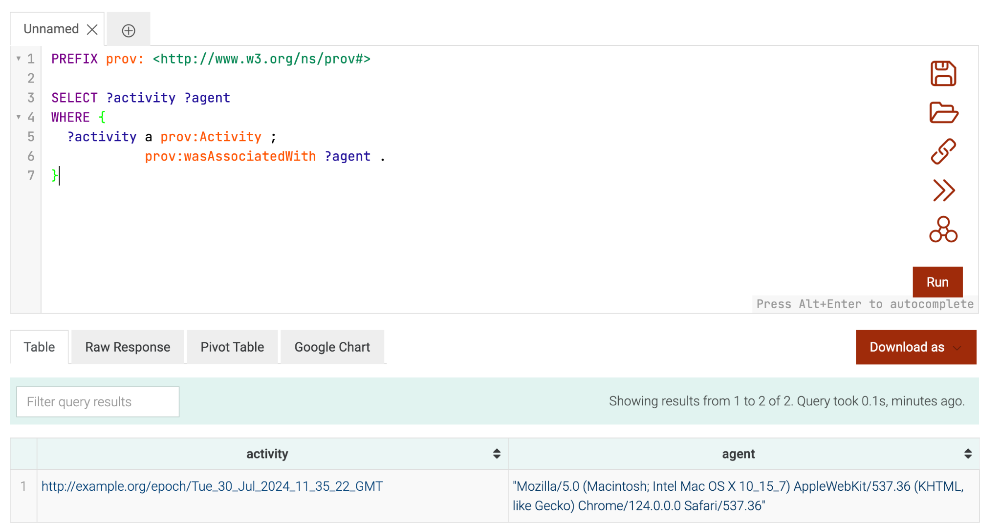
Demo

Slide 6
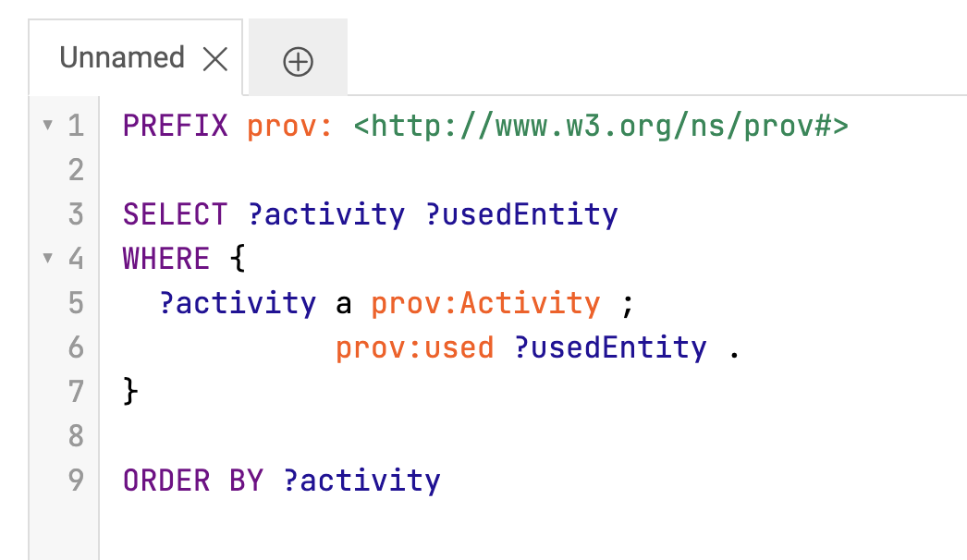
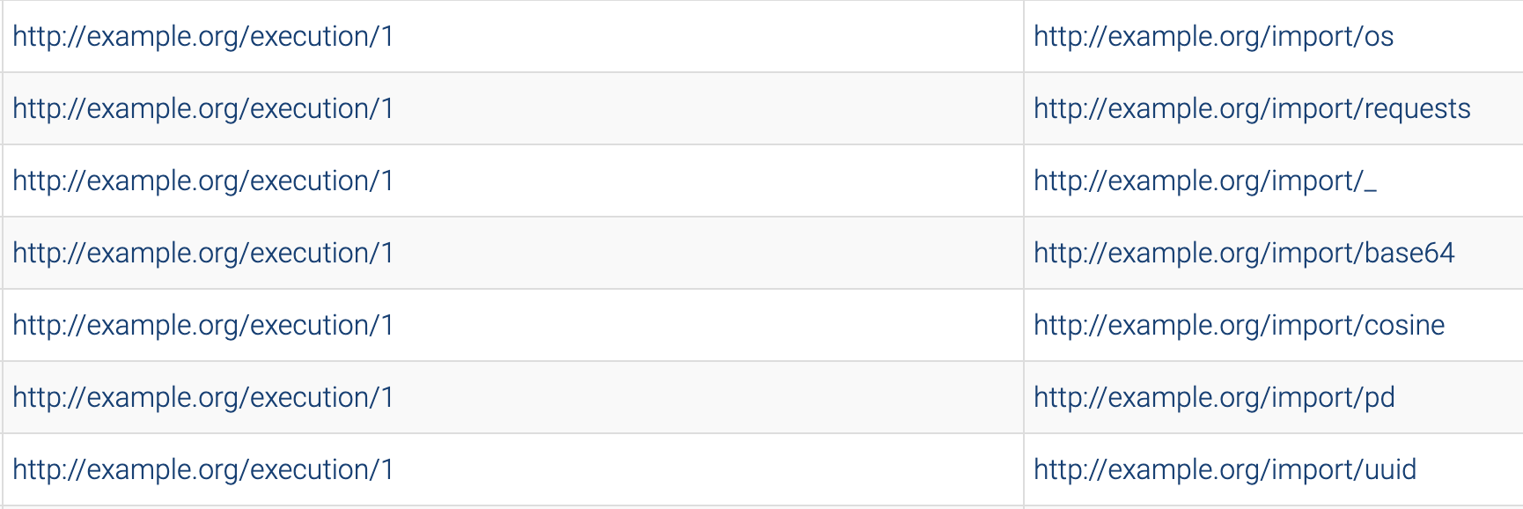
Demo

Slide 7
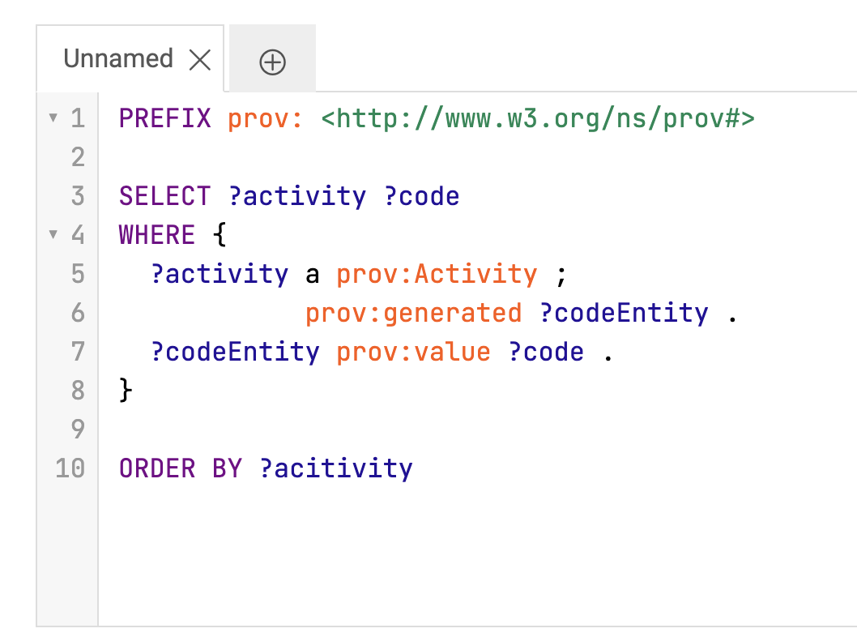
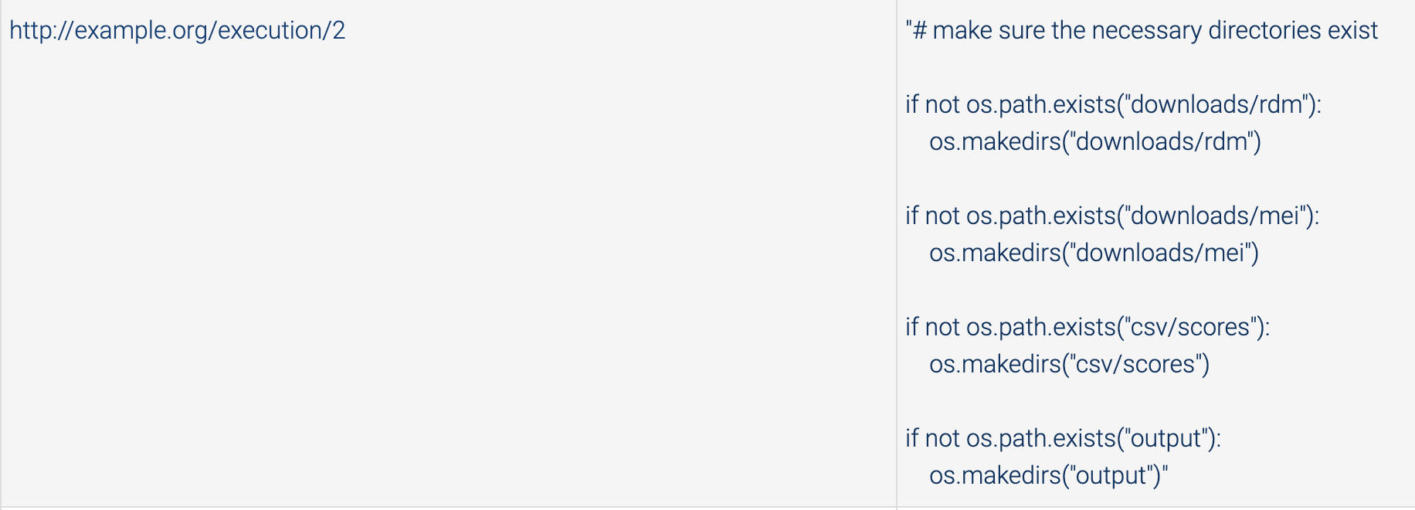
Demo

Slide 8
Connection to the project
Metadata and Annotations:
Once the annotations for the project are completed, PROV-O can also be used to describe the provenance of this metadata.
Why Use PROV-O?:
Provides a structured and standardized format for capturing the origin and history of the annotations.
Ensures that the metadata associated with annotations is traceable.

